Slide 1
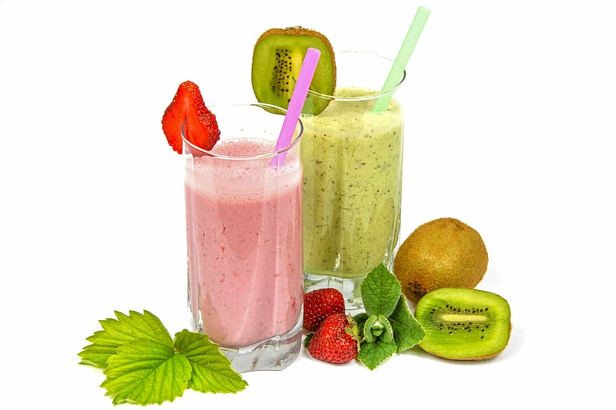
“OBLIQ”
A Tasty and Healthy Meal Replacement Shake
100% natural ingredients, no added sugar

Slide 2
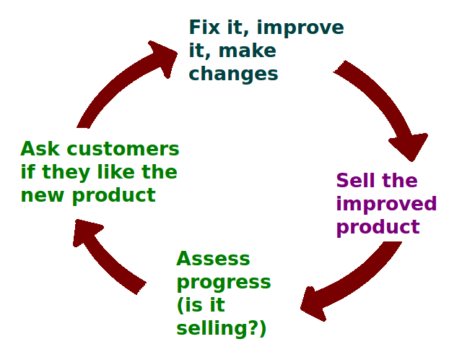

Research Objectives
Profitability
Meeting Customers Demand
Differentiation and Uniqueness
Creating Memorable Experience
Expansion & Growth
Promoting a Healthy Lifestyle

Slide 3

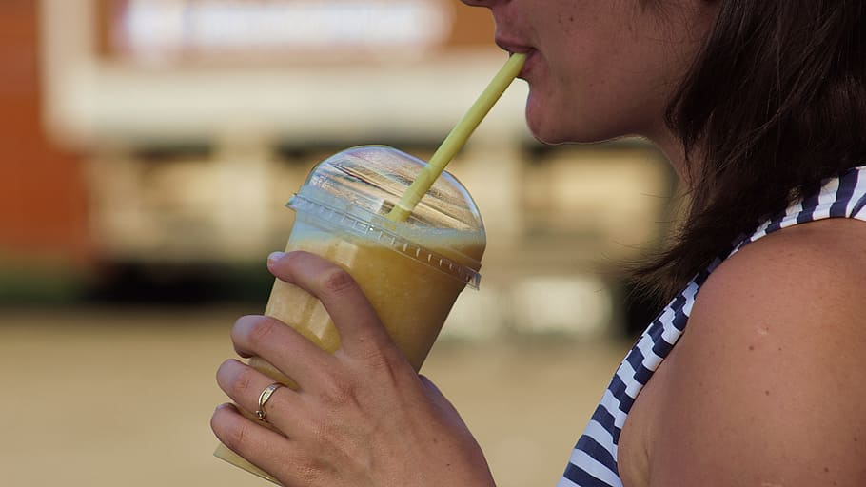
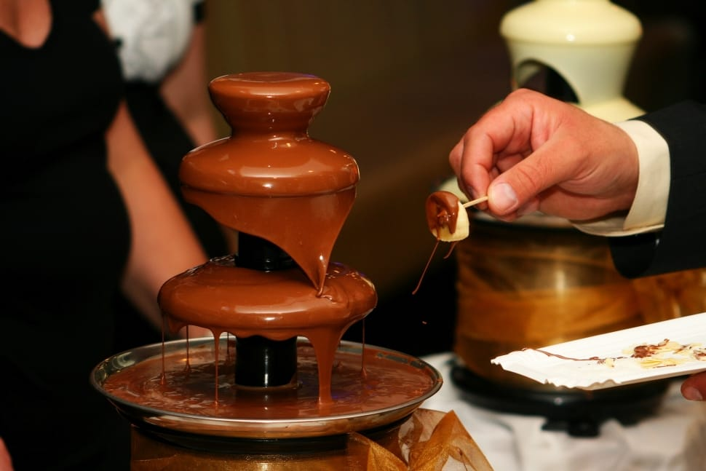


Who are the target consumers of the brand ?
Childrens & Teenagers
Young adults & college students
Families
Dessert Enthusiasts
Health conscious-consumers
Tourists & visitors

Slide 4

First one that you will try to sell?
The target consumers for the brand 'obliq' are health-conscious individuals who are looking for a convenient and nutritious meal replacement option. The primary target audience for the initial sales efforts will be urban professionals, specifically those working in corporate environments. They often have busy schedules and may not have time for a proper meal during the day. By providing a filling and nutritious shake, 'obliq' can cater to their needs.

Slide 5
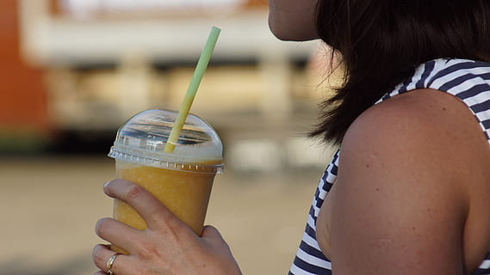

Wide Appeal
Shakes are generally popular among childrens & teenagers due to their sweet and indulgent nature.
They often crave treats and are more likely to be open to try new flavors and combinations .
Childrens and teenagers are more likely to become repeat customers.

Slide 6
Influence on Family Decisions
By targeting children's and teenagers you can indirectly reach their parents or guardians.
Word of Mouth Marketing
Children’s & teenagers can be effective brand ambassadors if they enjoy your shakes & have a positive experience on your business .

Slide 7

How to reach the target consumers ?
Online Presence
Create a professional and visually appealing websites for your business, optimize it for search engines to improve your online visibility, utilize social media platforms such as Instagram, Facebook, Twitter etc.

Slide 8

Local Marketing
Engage in local marketing to target consumers in area, Distributing flyers or brochures in nearby schools, community centers or local events.
Promotions and Discount
Offer introductory promotions, loyalty programs or discount to incentivize customers to try your shakes, promote these offer through your website, social media platforms and local advertising .

Slide 9

Influencer Partnerships
Collaborate with influencers or bloggers who have a significant following in your target market.
Online Reviews and Testimonials
Encourage satisfied customers to leave positive reviews and testimonials on platforms such as Google My Business.

Slide 10
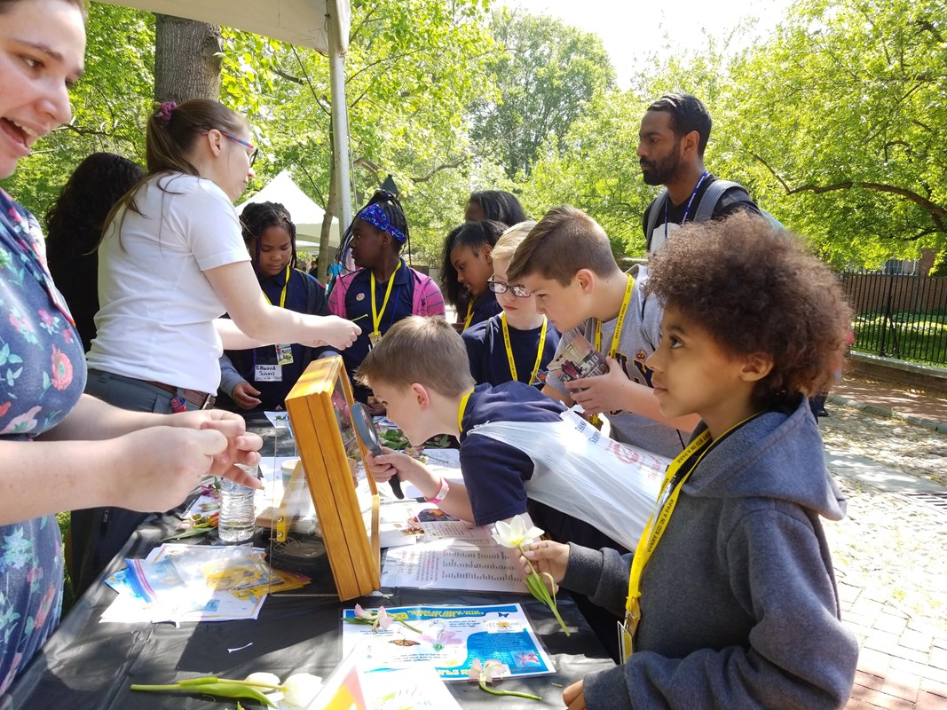

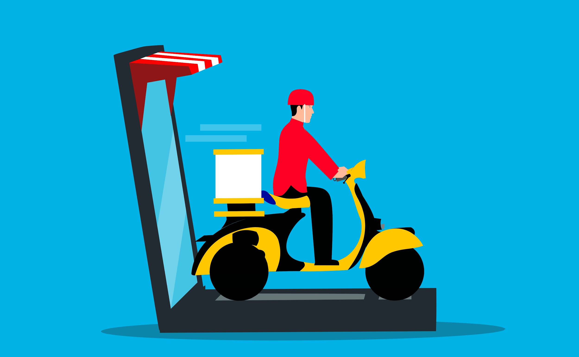
Customer referrals
Engage with online food communities
Collaborate with local schools and organization
Note- Regularly assess customer feedback and adapt your strategies accordingly to optimize your reach and engagements.

Slide 11
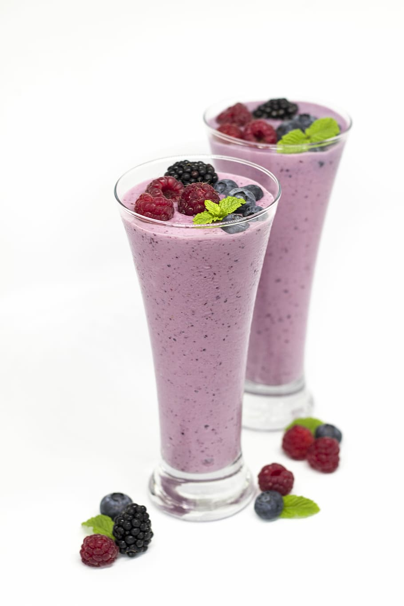
How to be different from others ?
Unique Flavours and Ingredients
Develop innovative and distinct shake recipes that stand out from the competition. Experiment with different combinations of ingredients, flavors, and textures to create signature shakes that customers can't find elsewhere.
Customization Options
By offering various toppings, mix-ins, or extra add-on.
Signature or Themed Shakes
Reflects your brand identity and local-culture.

Slide 12
Presentation and Aesthetics
Invest in attractive glassware, garnishes,and presentation techniques .
Health-Conscious Options
Offer a range of healthier shakes alternative to carter to health conscious consumers, such as low sugar, vegan or dairy free shakes made with nutritious ingredients.
Engaging and Interactive Experience
Hosting events workshops or competition related to shakes, encourage customers participation by allowing them to vote for new flavours or collaborate in the creation process.
Exceptional Customer-Services
Train your staff to be knowledgeable, Friendly and Attentive to customers needs.

Slide 13
Emphasize Sustainability
Using biodegradable or reusable straws, minimizing food waste. Sourcing ingredients from sustainable and ethical suppliers.
Social Media Presence and Storytelling
Develop a strong presence on social media platforms to show your shakes,Interact with customers.
Use visually appealing imagery, engaging captions and user generated content to build a community around your brand.
Note - Successful differentiation involves a combination of factors that align with your target market’s preference and needs continuously research your competitors listen to customers feedback and stay innovative to stay in the shakes industries.

Slide 14


How to sell to them ?
Develop a compelling value proposition
Engage with customers
Offer samples and demonstrations
Create attractive menu displays
Offer bundle deals or combos
Implement an online ordering system
Seek feedback & adapt
Note- Selling is not just about transactions but also building relationships, providing exceptional experiences and consistently delivering on your value propositions by focusing on needs and desires of target consumers.

Slide 15
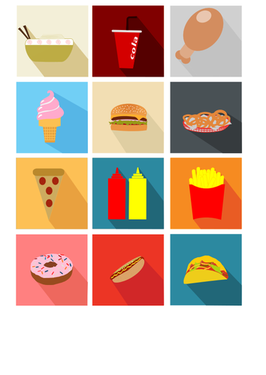
Who are the competitors
Fast-food chains
Ice-cream parlors
Speciality shakes business
Local cafes and dessert shops
Smoothie and juice bars
Note- Analyze their offerings, pricing, target demographics and marketing strategies to understand how you can differentiate your shakes business and appeal to your target customers effectively.

Slide 16
THANK YOU
Created by- ARPIT CHAUDHARY

